Slide 1
Mini Project On Predicting sales using Machine Learning Techniques
Manas Ghodke
DSFT 8

Slide 2
Problem Statement or Business Problem
In this project, looking at the various Stores Sales around the world are tasked with predicting their daily sales in advance.
Store sales are influenced by many factors, including promotions, competition, school and state holidays, seasonality, and locality.
With thousands of sales records we will be predicting sales based on their unique circumstances, the accuracy of results can be quite varied The task is to forecast the “Sales” column.

Slide 3
OBJECTIVES
This analysis will help to identify the critical features that influence sales and also an experiment is performed to find the best suitable algorithm for sales forecasting.
This analysis aims to develop a Machine Learning model that can predict the sales of products from different outlets. Several objectives were drawn to attain the goal:
Converting data into an appropriate form using various preprocessing techniques for the implementation of Machine Learning algorithms.
Finding critical features that will most influence sales of the product.
To determine the appropriate Machine Learning algorithm for sales forecasting.
Selecting various metrics to compare the performance of the applied Machine

Slide 4
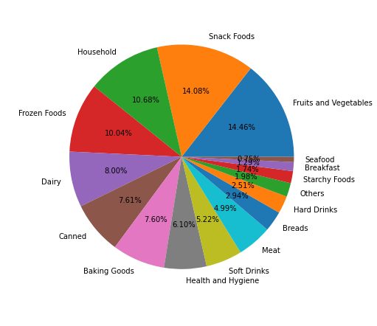
Analysis of Item Type
Here we can clearly see that Products like fruits and vegetables and snack foods are in more demand and are preferred my most of the customers. So we can focus more on these items in order to increase the sales of the stores

Slide 5
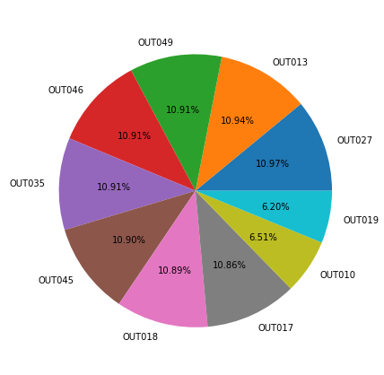
Analysis of Outlet Identifier
Here, two of the outlets(OUT010 and OUT019) have lesser sales.
The highest sales is at OUT027.

Slide 6
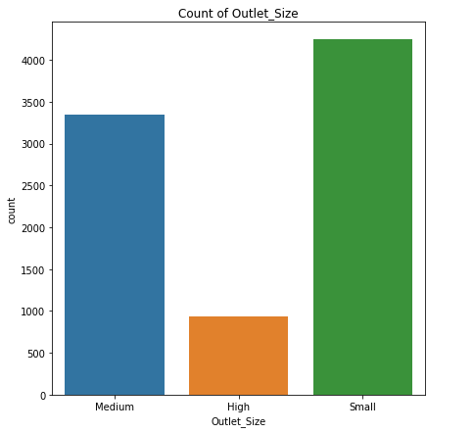
Analysis of Outlet Size
From the above graph it is seen that Medium and small size stores are preferred more rather than the High
sized stores.

Slide 7
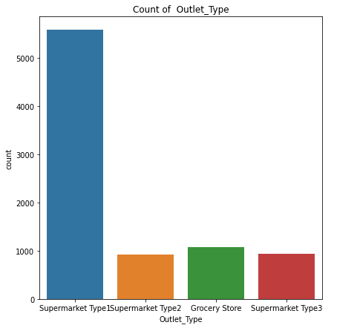
Analysis of Outlet Type
The results from analysis of Outlet Type show that Supermarket Type1 has the highest sales

Slide 8
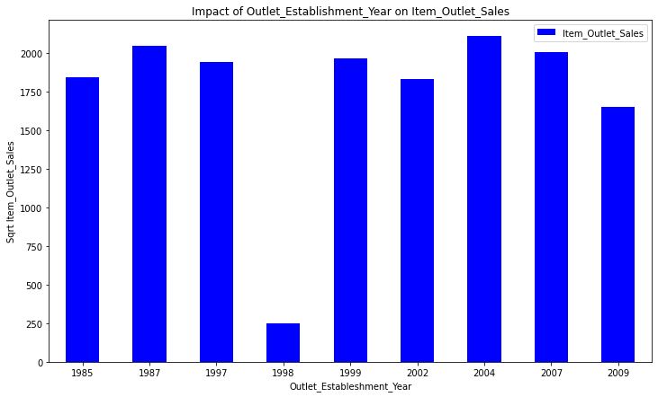
Analysis on Outlet_Establishment_Year
From the bar chart it is seen that the year 1998 has the lowest sales.It is also analyzed that there seems to be no significance between the year of establishment and Sales as the variables are independent of each other.

Slide 9
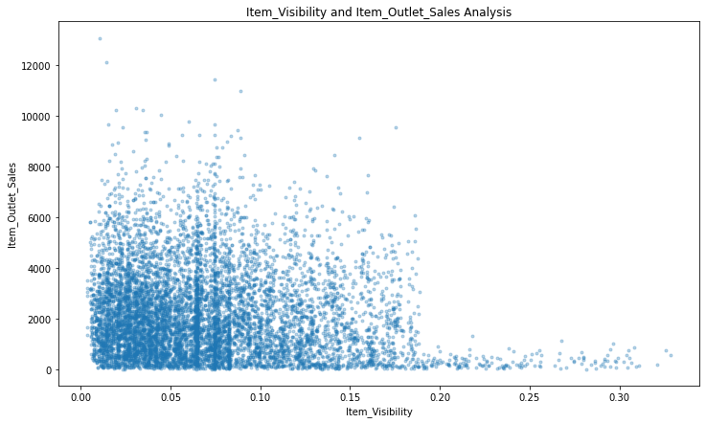
Analysis on Item Visibility
The location of product in a store will impact the sales. Ones which are kept at the entrance will catch the customers attention rather than the ones in back.

Slide 10
Results of The Different algorithms Used To Train & Test The Models
 | R2_score(Train Dataset) | R2_score(Test Dataset)
Linear Regression | 0.4855460149993043 | 0.4923556967454268
Decision Tree Regressor | 0.5662047748923439 | 0.5805567869628294
Bayesian Regressor | 0.4856731085481557 | 0.49126736549342787

Slide 11
Selection of Machine Learning Algorithms
We have selected Random Forest Regressor algorithm for training our model.
A Random Forest is an ensemble technique qualified for performing classification and regression tasks with the help of multiple decision trees and a method called Bootstrap Aggregation known as Bagging .
5 Decision Trees are used in classification and regression tasks, where the model (tree) is formed of nodes and branches.
The tree starts with a root node, while the internal nodes correspond to an input attribute. The nodes that do not have children are called leaves, where each leaf performs the prediction of the output variable .

Slide 12
THANK YOU

